Slide 1
Computer Vision
Fundamentals of Artificial Intelligence

Slide 2
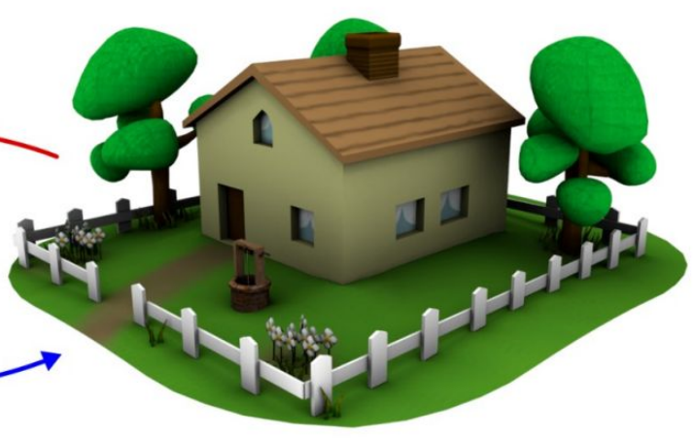
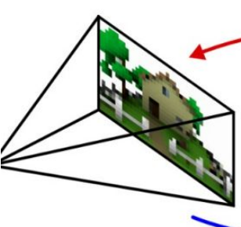
Goal of Computer Vision
extract semantic information from digital image data
to be used for decision making support or automated systems
challenging problem:
images are only 2D projections of the 3D world
nowadays heavily powered by artificial intelligence (AI), especially machine learning (ML)

Slide 3
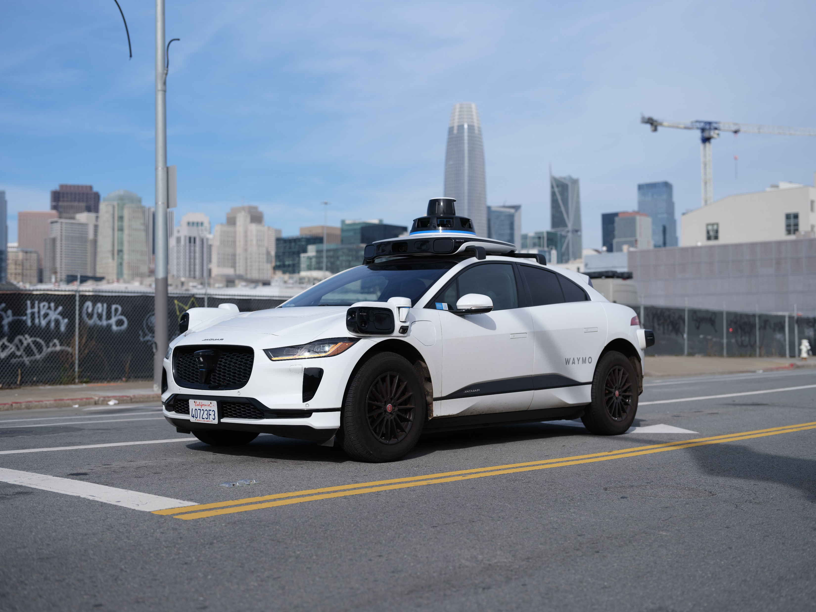


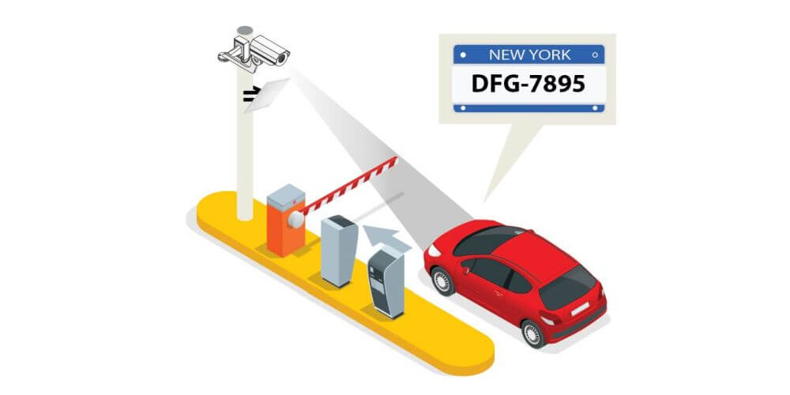
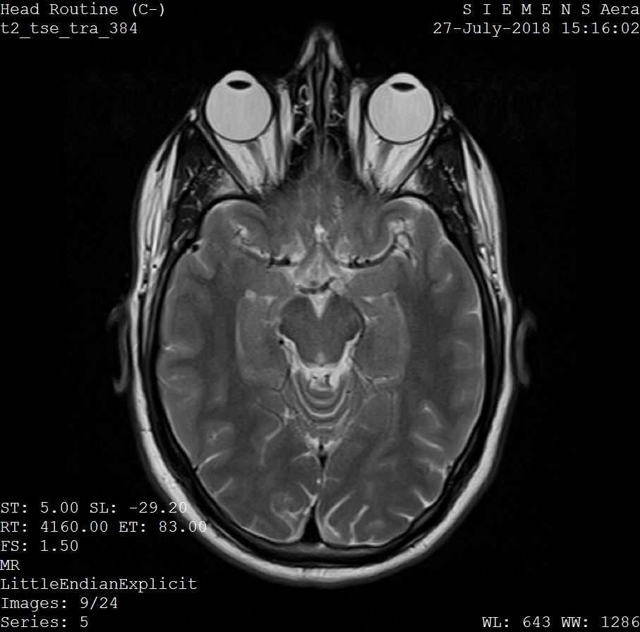
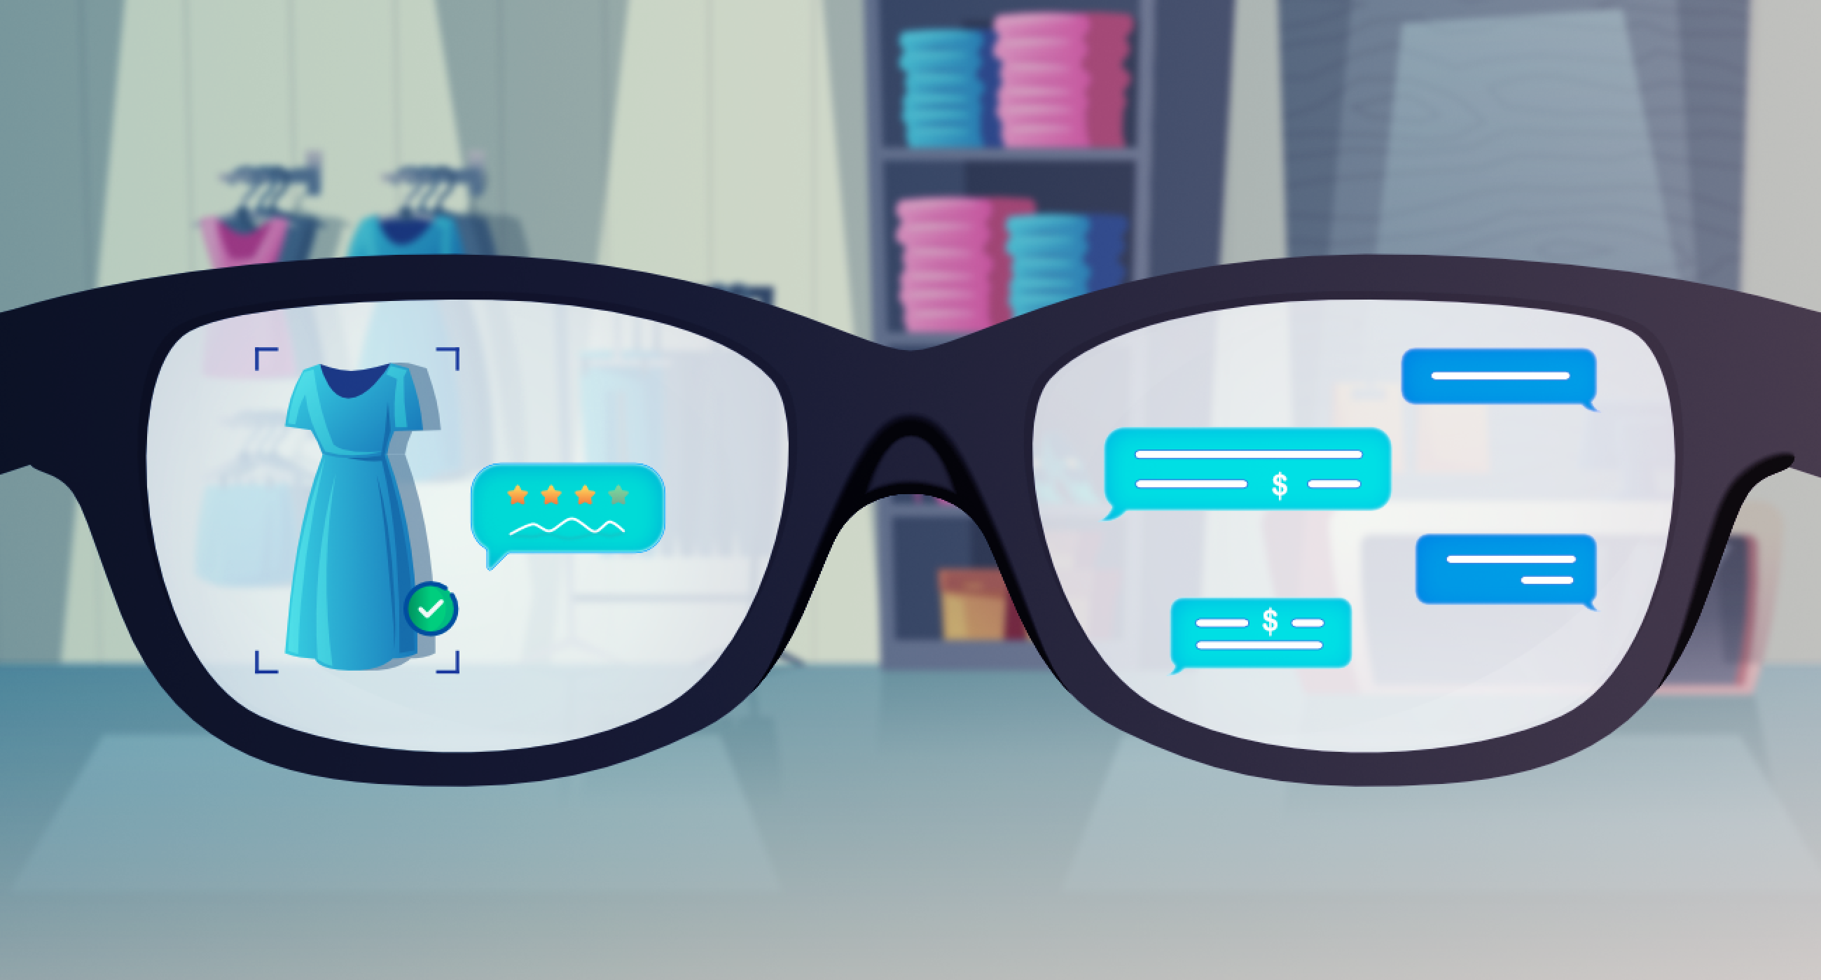
Applications of Computer Vision
autonomous driving
facial recognition
automated inspection
medical imaging
optical character recognition
augmented reality
and many more …

Slide 4
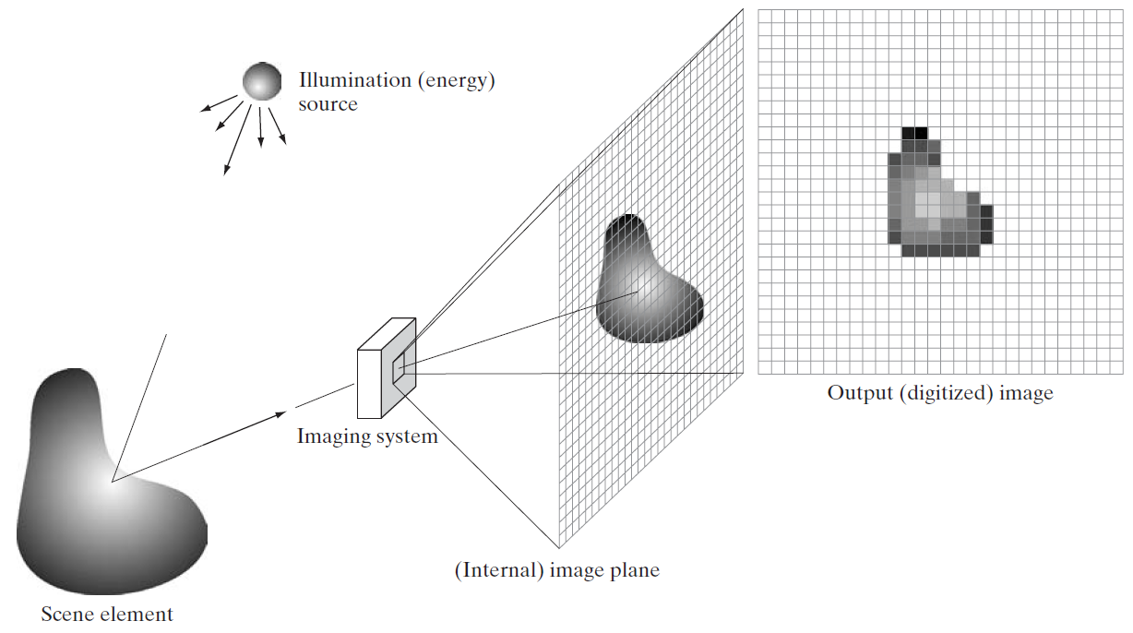
Digital Image Acquisition Process
e.g., lens to focus light on image plane
reflection or absorption (e.g., X-rays) of energy

Slide 5
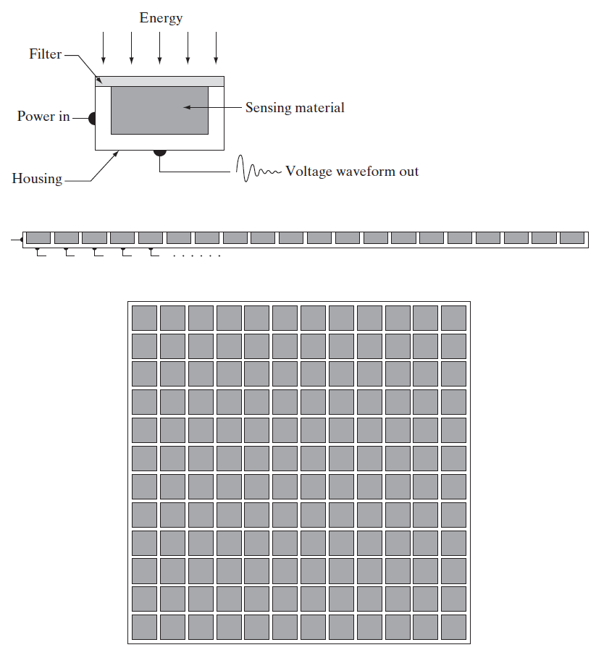
Photons to Electrons
largely replaced chemical and analog imaging
single sensor: photodiode
sensor strips: motion perpendicular to strip for imaging in other direction, used in CT
sensor arrays: used in digital cameras (in focal plane, outputs proportional to integral of light received at each sensor)
to be digitized

Slide 6
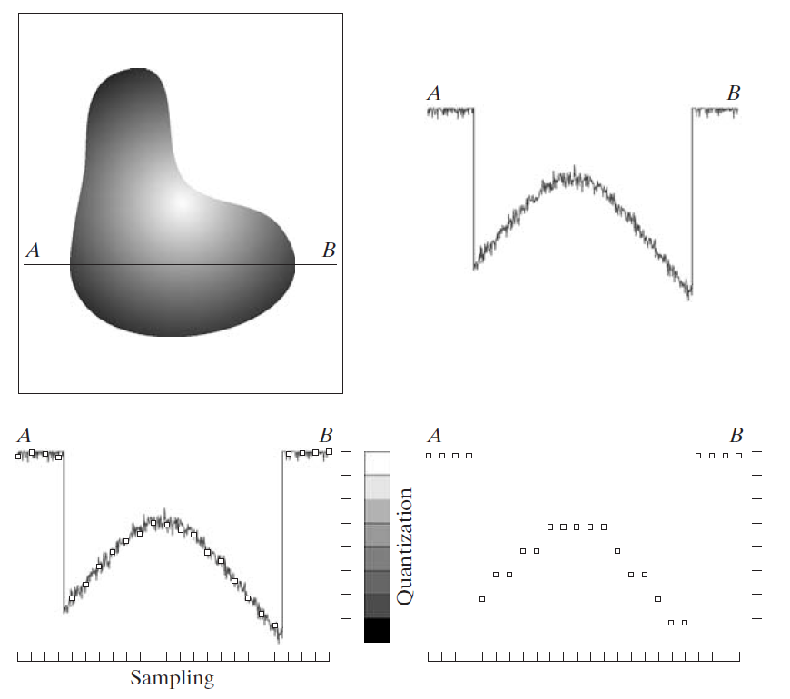
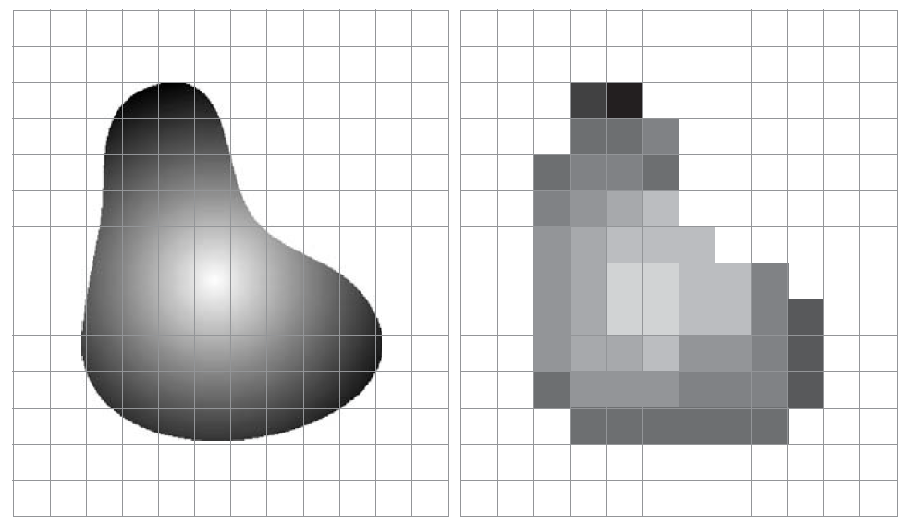
Digitizing: Sampling & Quantization
digitizing the coordinate values: pixels
digitizing the amplitude values: discrete intensity levels

Slide 7

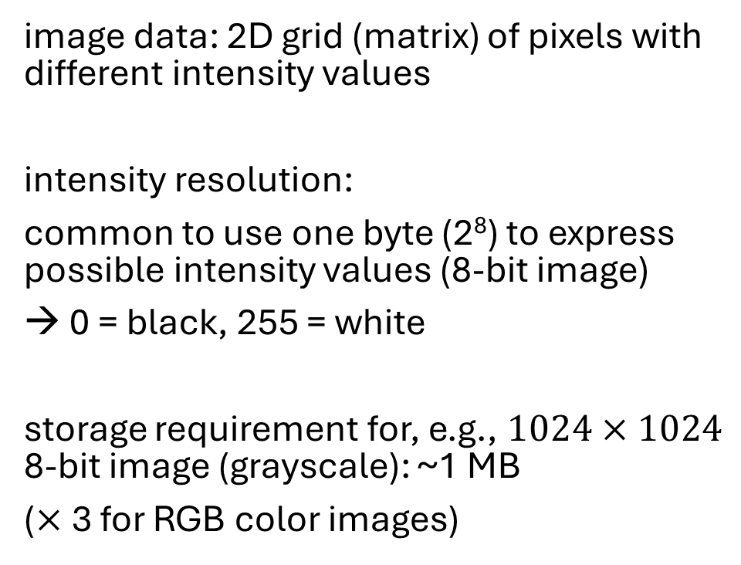
Discrete Intensity Levels
image data: 2D grid (matrix) of pixels with different intensity values
intensity resolution:
common to use one byte (2⁸) to express possible intensity values (8-bit image)
→ 0 = black, 255 = white
storage requirement for, e.g., $1024×1024$ 8-bit image (grayscale): ~1 MB
($×$3 for RGB color images)
source

Slide 8
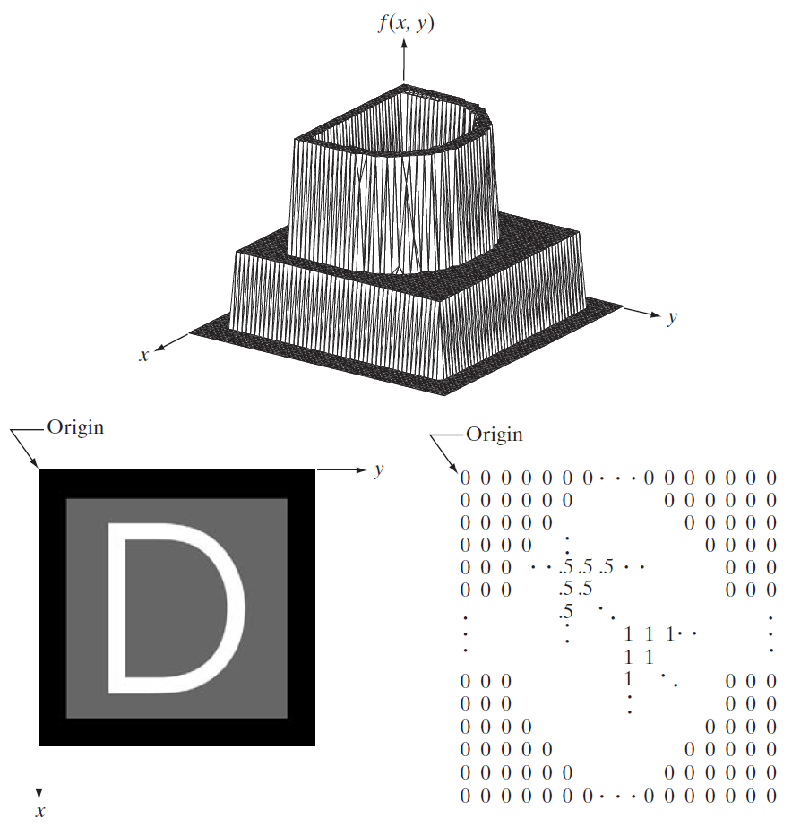
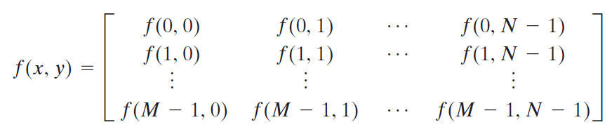
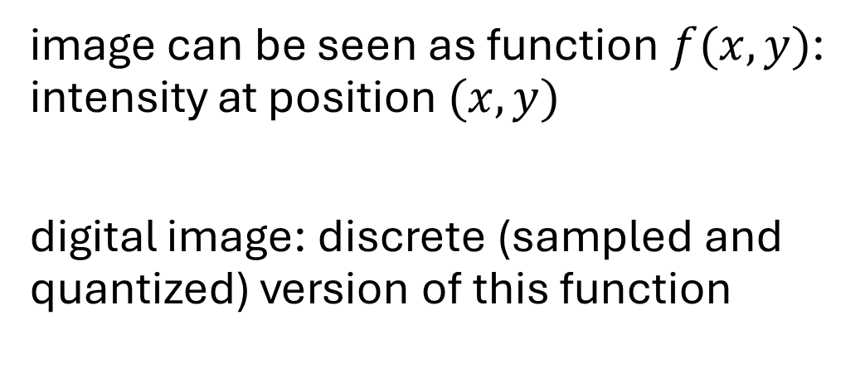
Image as Two-Dimensional Function
image can be seen as function $f(x,y)$: intensity at position $(x,y)$
digital image: discrete (sampled and quantized) version of this function

Slide 9
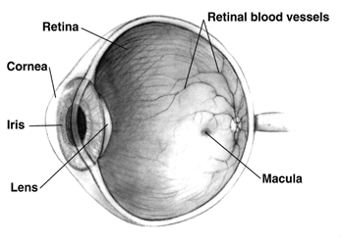
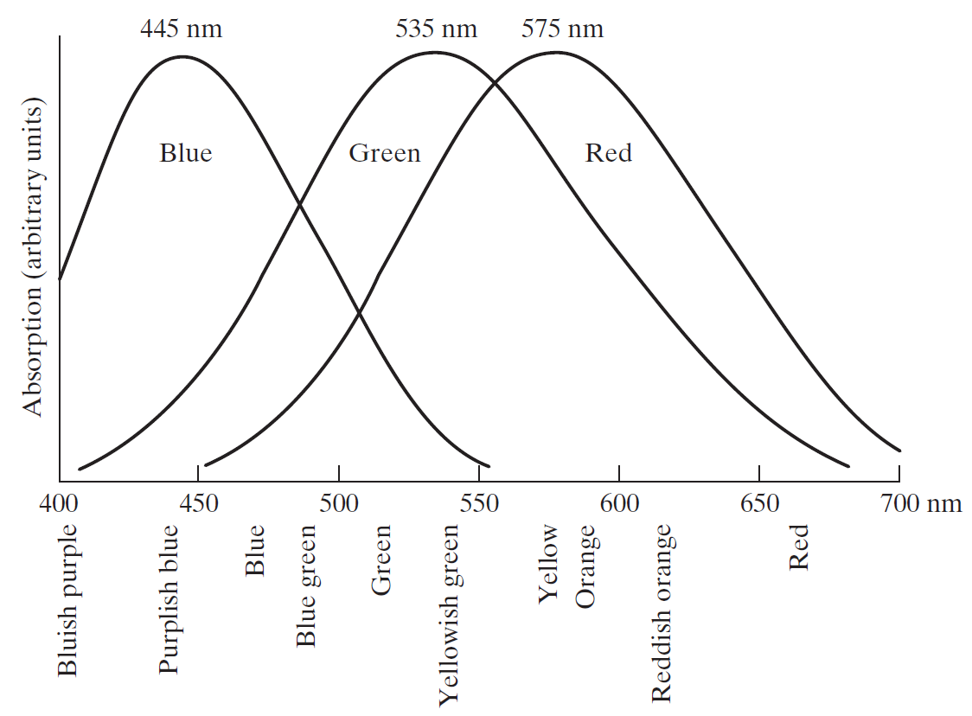
Colors in the Human Eye
retina: image sensor of human eye
two kinds of light receptors on surface of retina: rods (monochromatic vision) and cones (color-sensitve cells)
three types of cones: red, green, blue
→ combinations of red, green, and blue create perceived colors

Slide 10
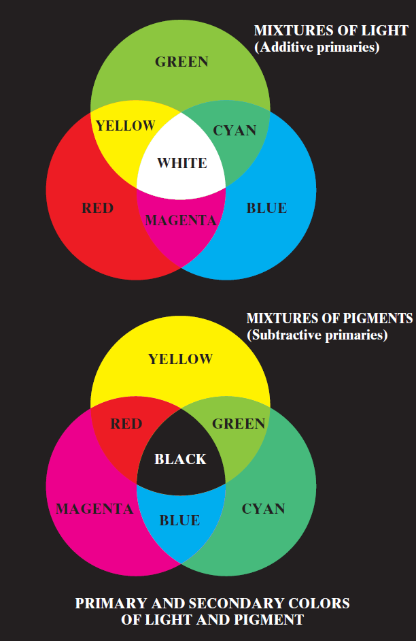
Primary Colors
standardization:
use of specific wavelengths for three primary colors red, green, and blue
→ can reproduce (almost) all visible colors by mixing with different intensities
for printing:
primary colors of pigments each absorb one primary color of light

Slide 11
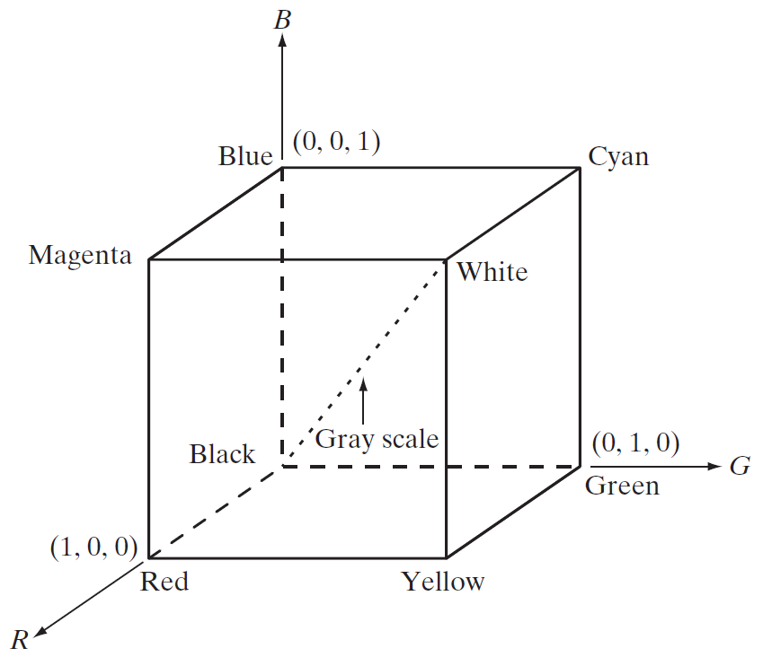
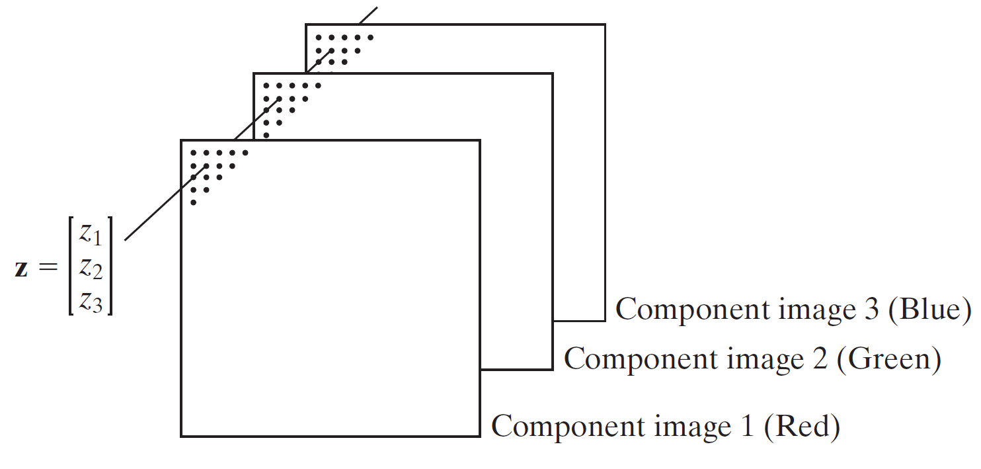
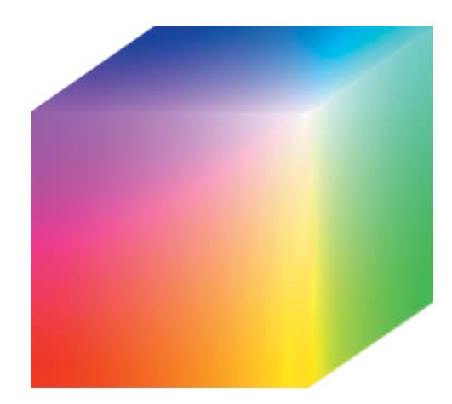
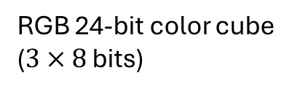
RGB Color Model
color model for monitors and cameras
(other color models: CMYK, HSV, ...)
color pixels:
3 intensity “channels”
RGB 24-bit color cube
($3×8$ bits)

Slide 12
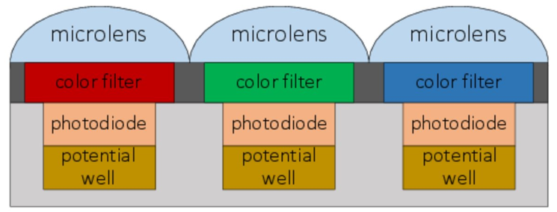
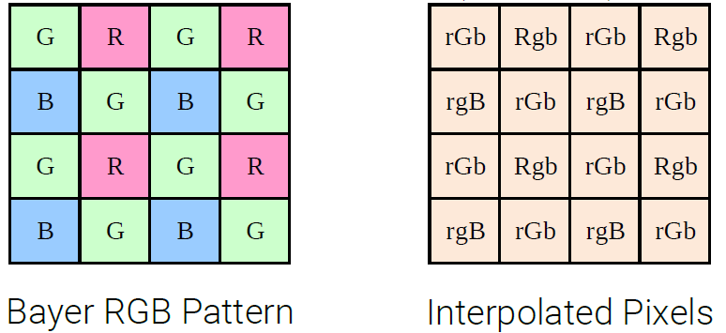
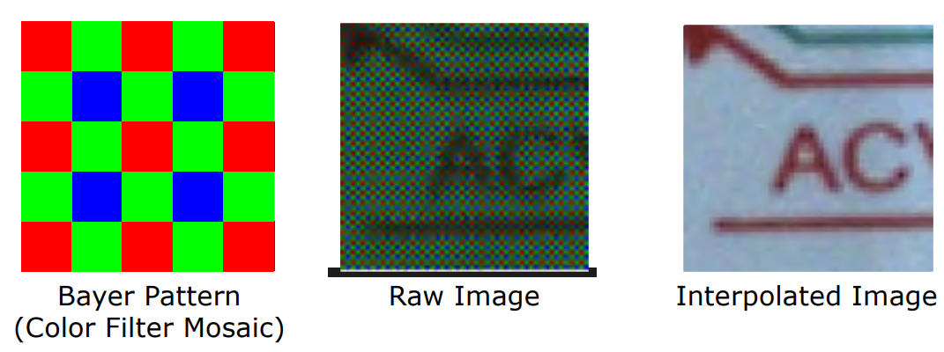
Color Sensing
single image sensor with one of three color filters in front of each pixel
estimation of missing color values for each pixel by interpolation from neighboring pixels
→ full-color image

Slide 13
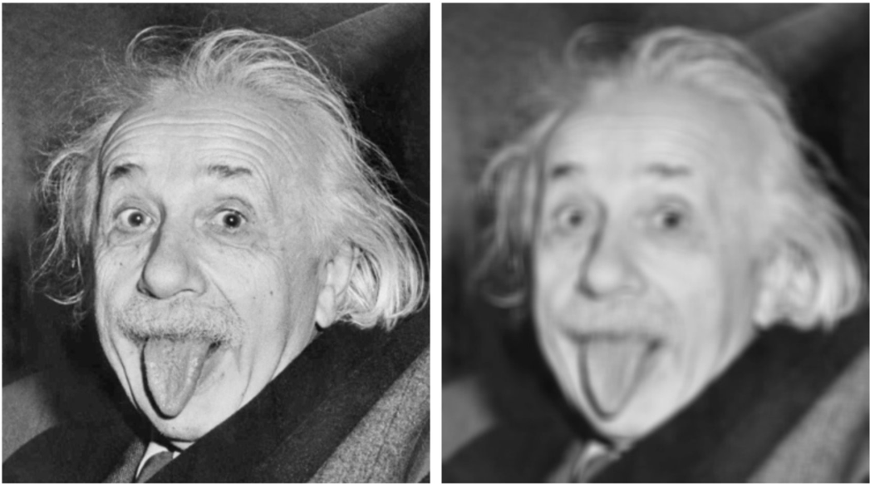
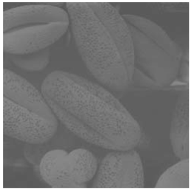
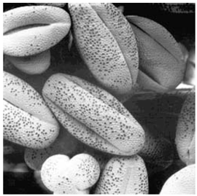
Image Processing
transformations from image to image
(such as scaling, smoothing, sharpening, or contrast stretching)
to facilitate either machine perception or just human interpretation

Slide 14
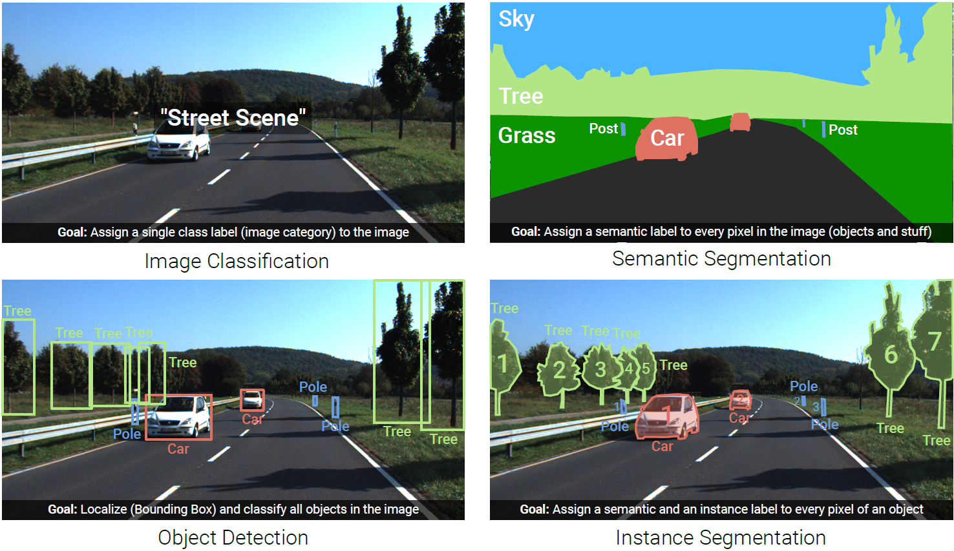
Image Understanding (Recognition)

Slide 15
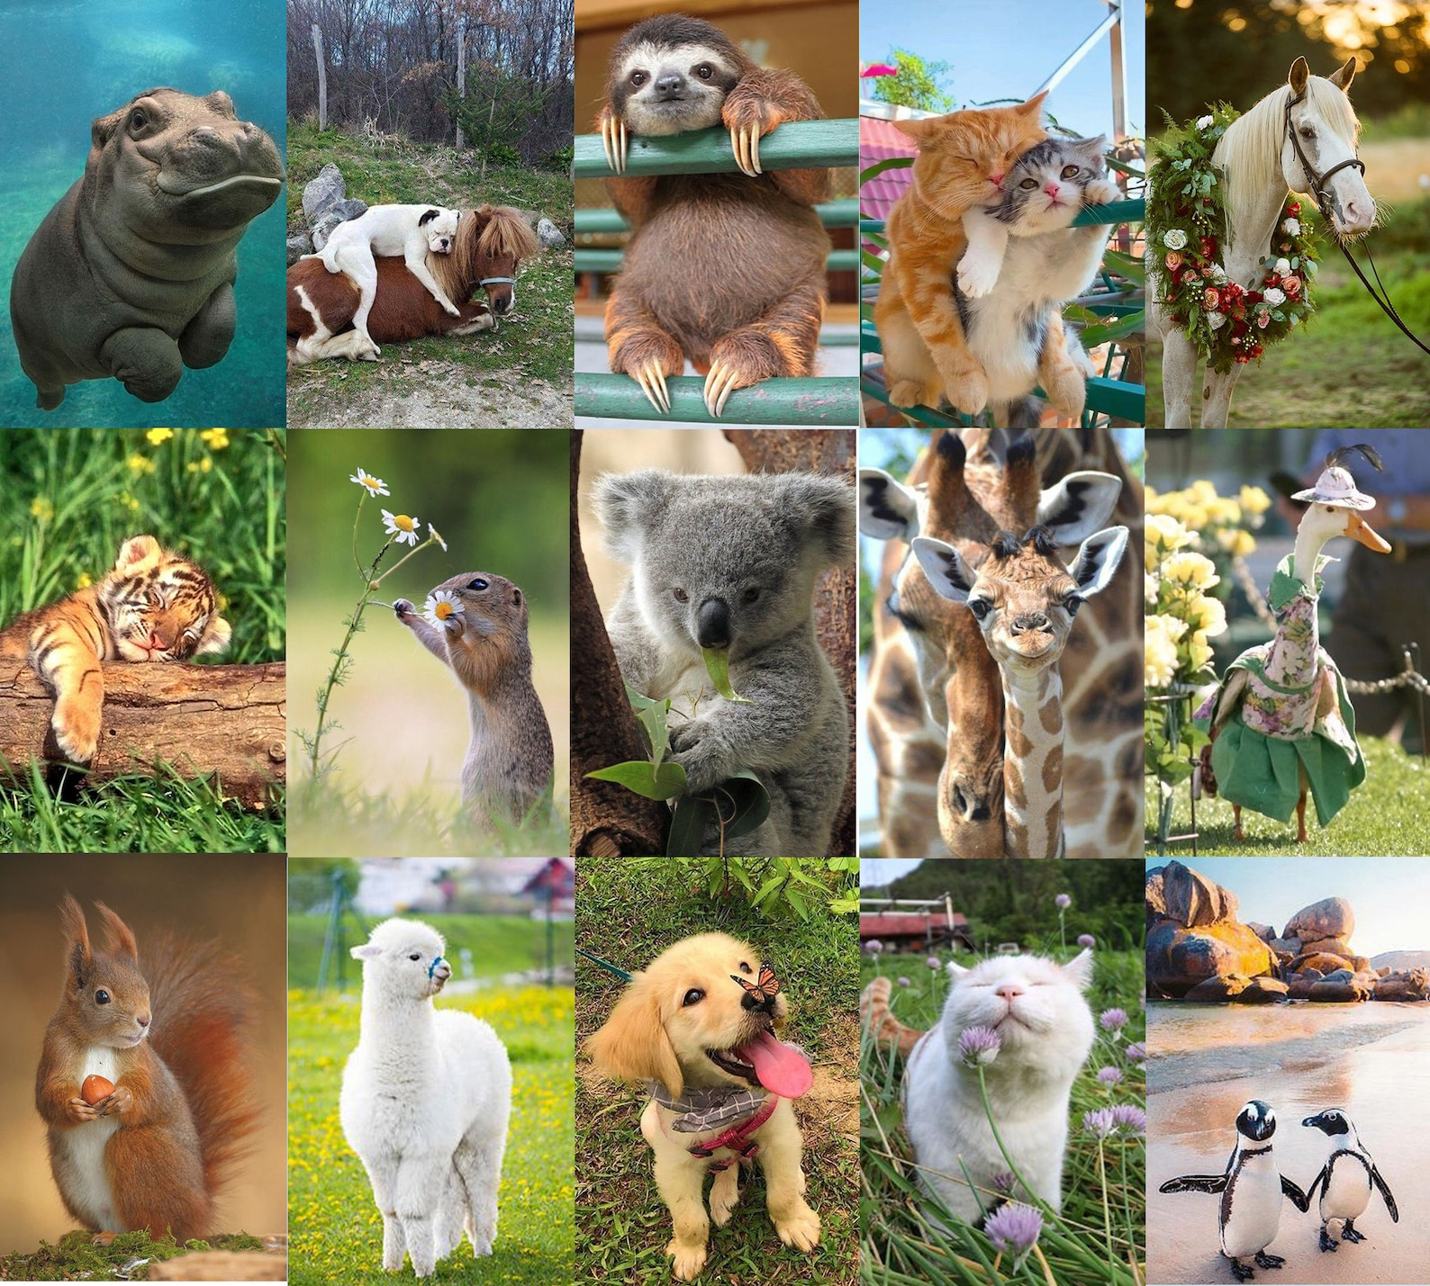
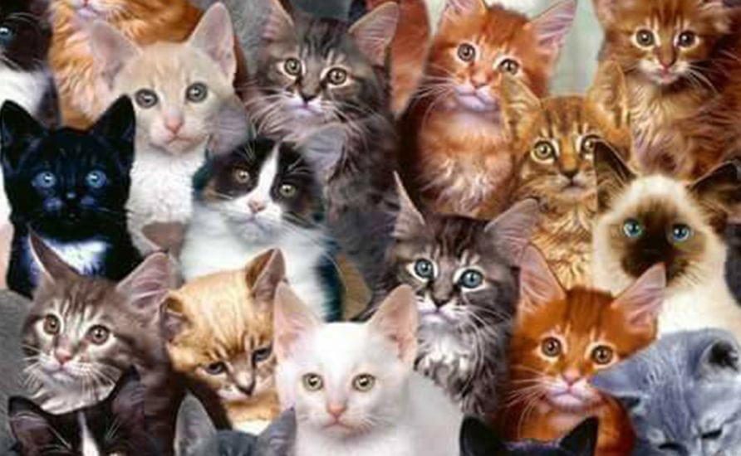
Need for ML
prime example (and also foundation for detection and segmentation):
image classification (whole-image class recognition) according to generic object categories (e.g., cat)
plain keypoint-feature matching only really works for specific instances of a class
→ need to compare with generic objects (e.g., kind of “abstract cat”)
Let’s learn it from data …
What if you haven’t seen this very cat before?

Slide 16
Image Classification

Slide 17
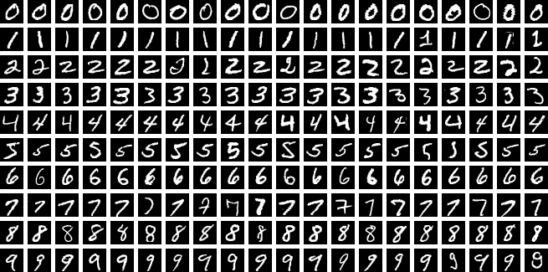
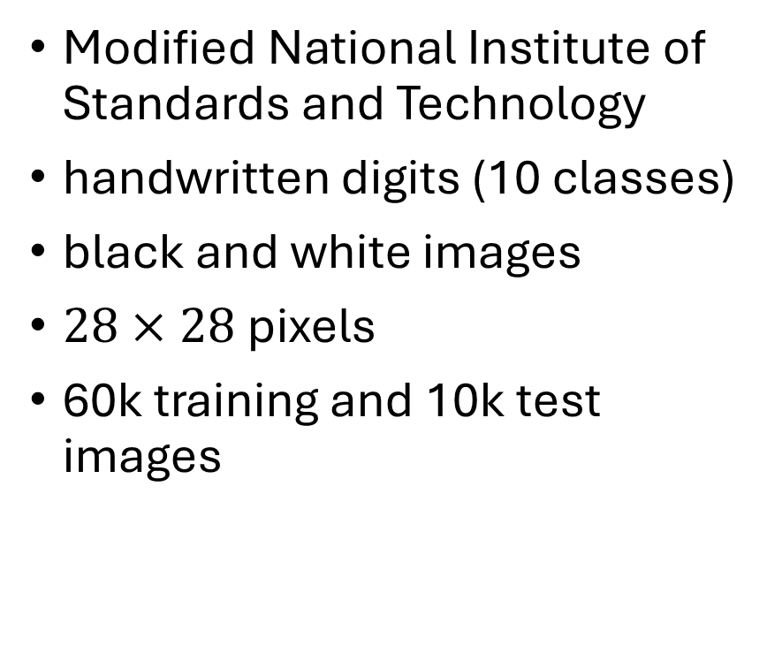
MNIST
Modified National Institute of Standards and Technology
handwritten digits (10 classes)
black and white images
$28×28$ pixels
60k training and 10k test images

Slide 18
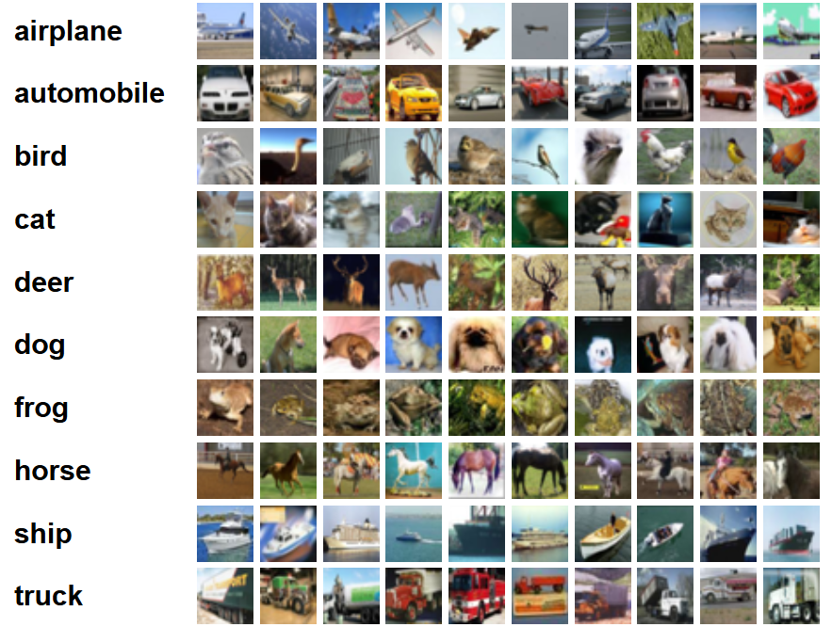
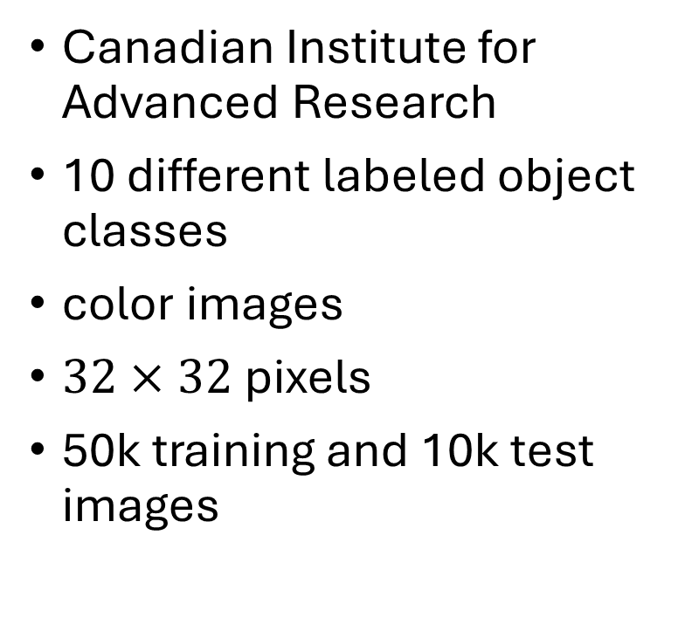
CIFAR-10
Canadian Institute for Advanced Research
10 different labeled object classes
color images
$32×32$ pixels
50k training and 10k test images

Slide 19
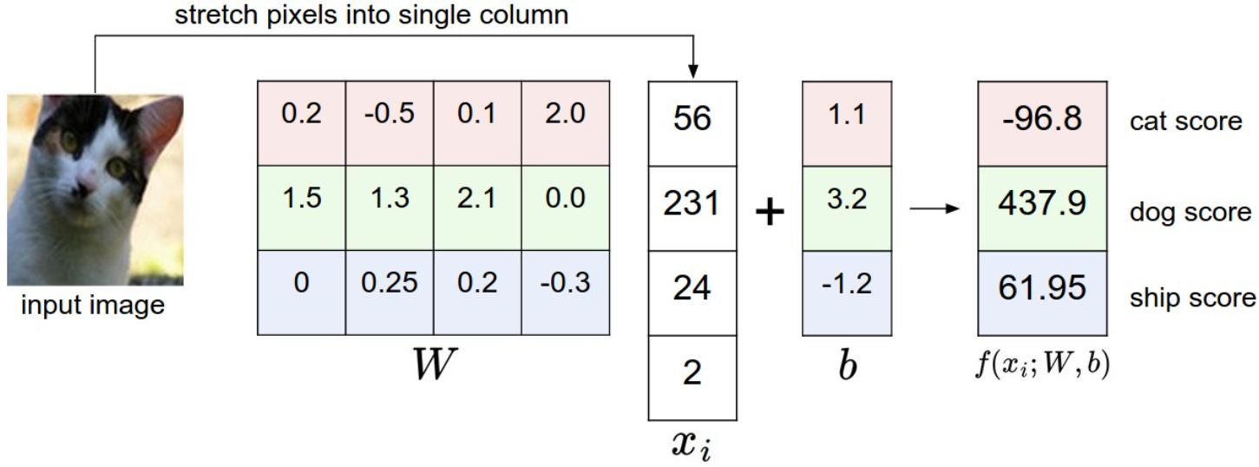
Image Classification with Linear Regression
simplified example: 4-pixel image, 3 classes
matrix
intensity values
need for one common image size per model

Slide 20
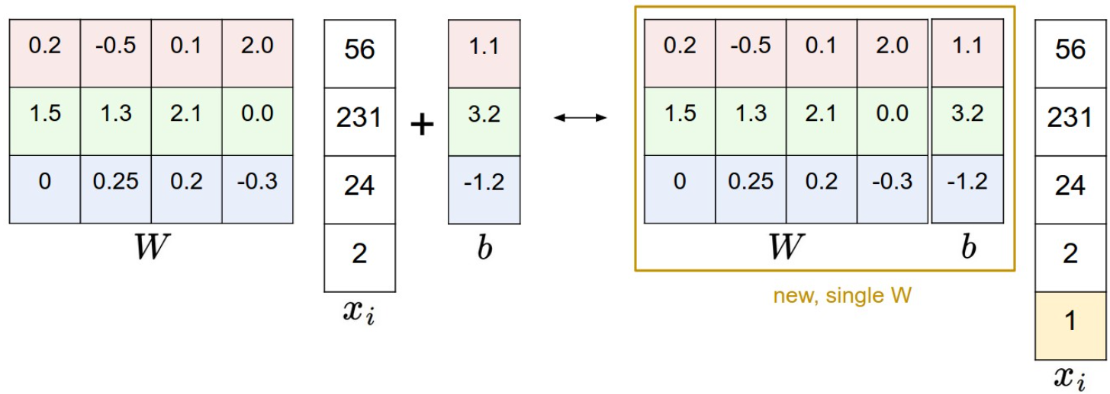
Simplified Matrix Multiplication: Bias Trick

Slide 21
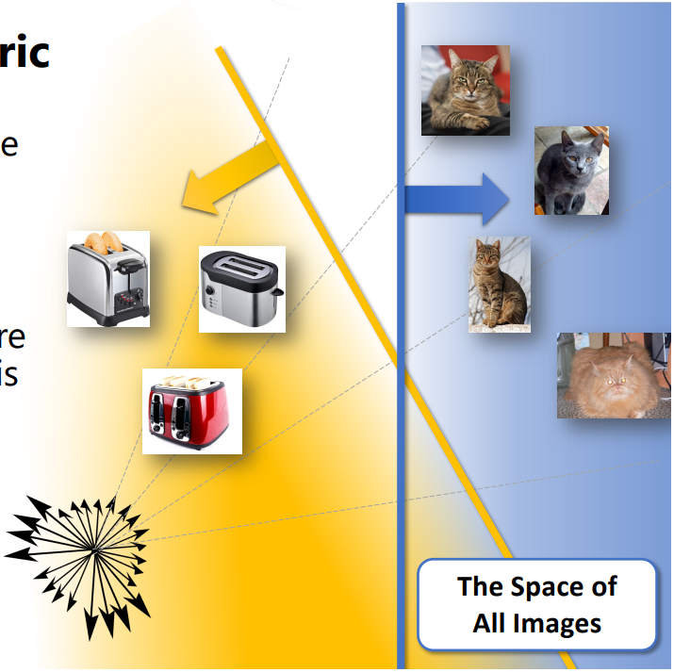
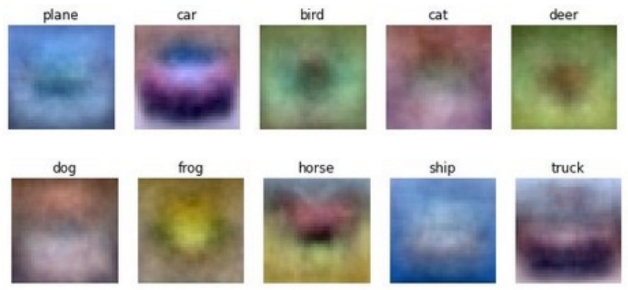
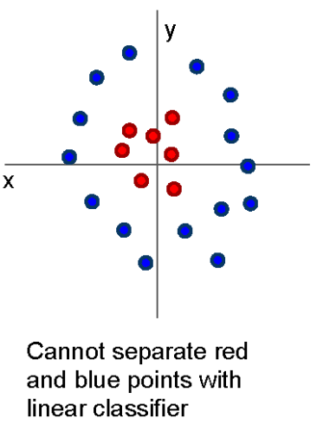
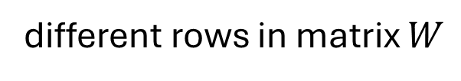
geometric interpretation:
separating hyperplanes
matching interpretation:
generic class templates
different rows in matrix $W$
raw-pixel images not linearly separable
→ linear model has not enough representational power

Slide 22
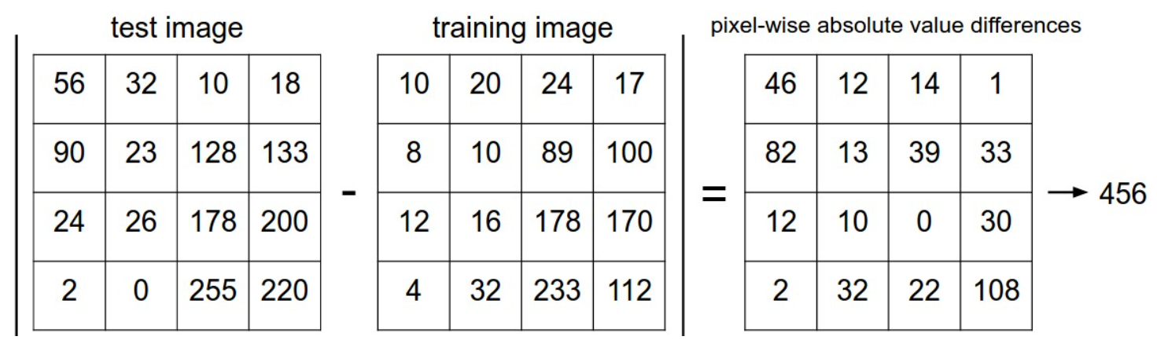

Image Classification with kNN
choose an image distance, e.g., L1 distance:
$$d\left(I_{1},I_{2}\right)=\sum_{p}{\left|I_{1}\left(p\right)−I_{2}\left(p\right)\right|}$$

Slide 23
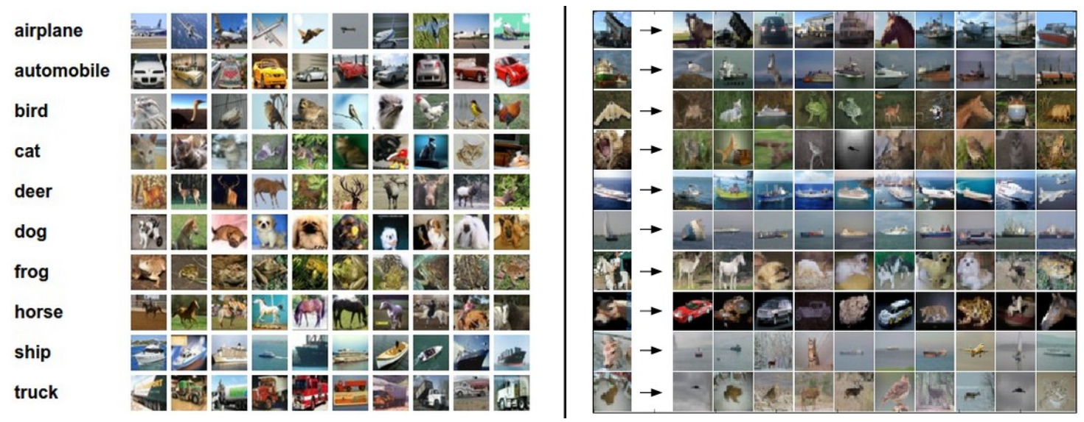
Image Classification with kNN
training examples CIFAR-10 data set
10 nearest neighbors to some test images
10 classes
better than random guessing, but also not very impressive

Slide 24
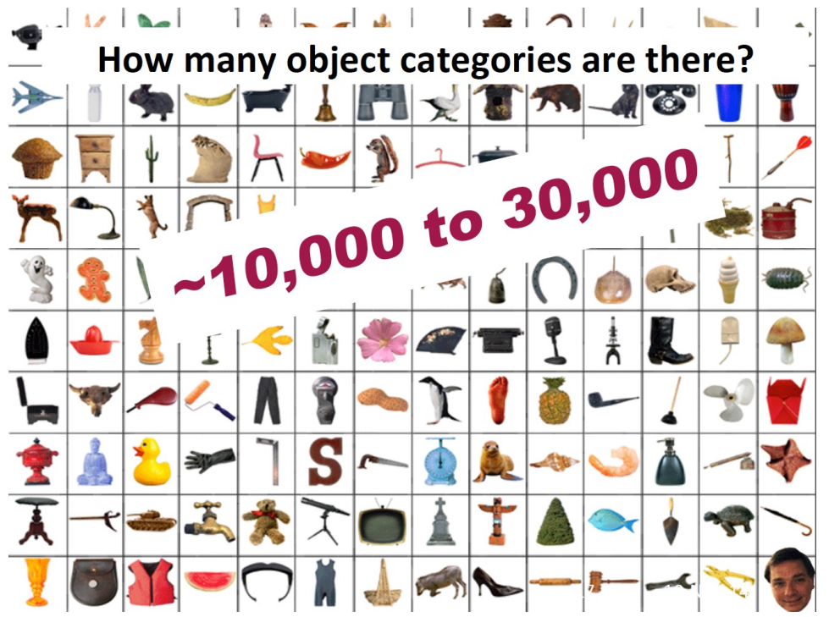
In Reality: Lots of Categories

Slide 25
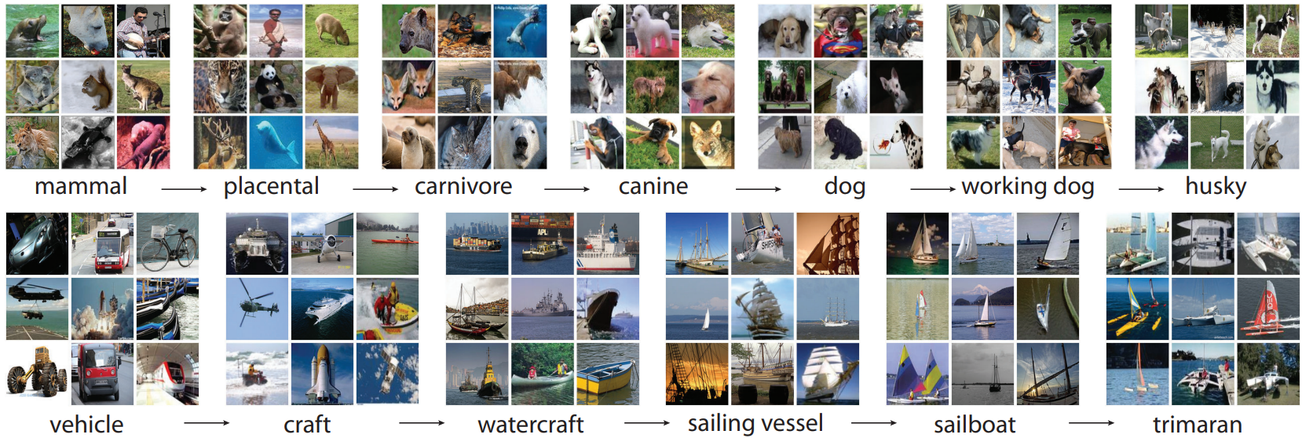
ImageNet
more than 14 million color images with varying sizes
more than 20k labeled categories

Slide 26
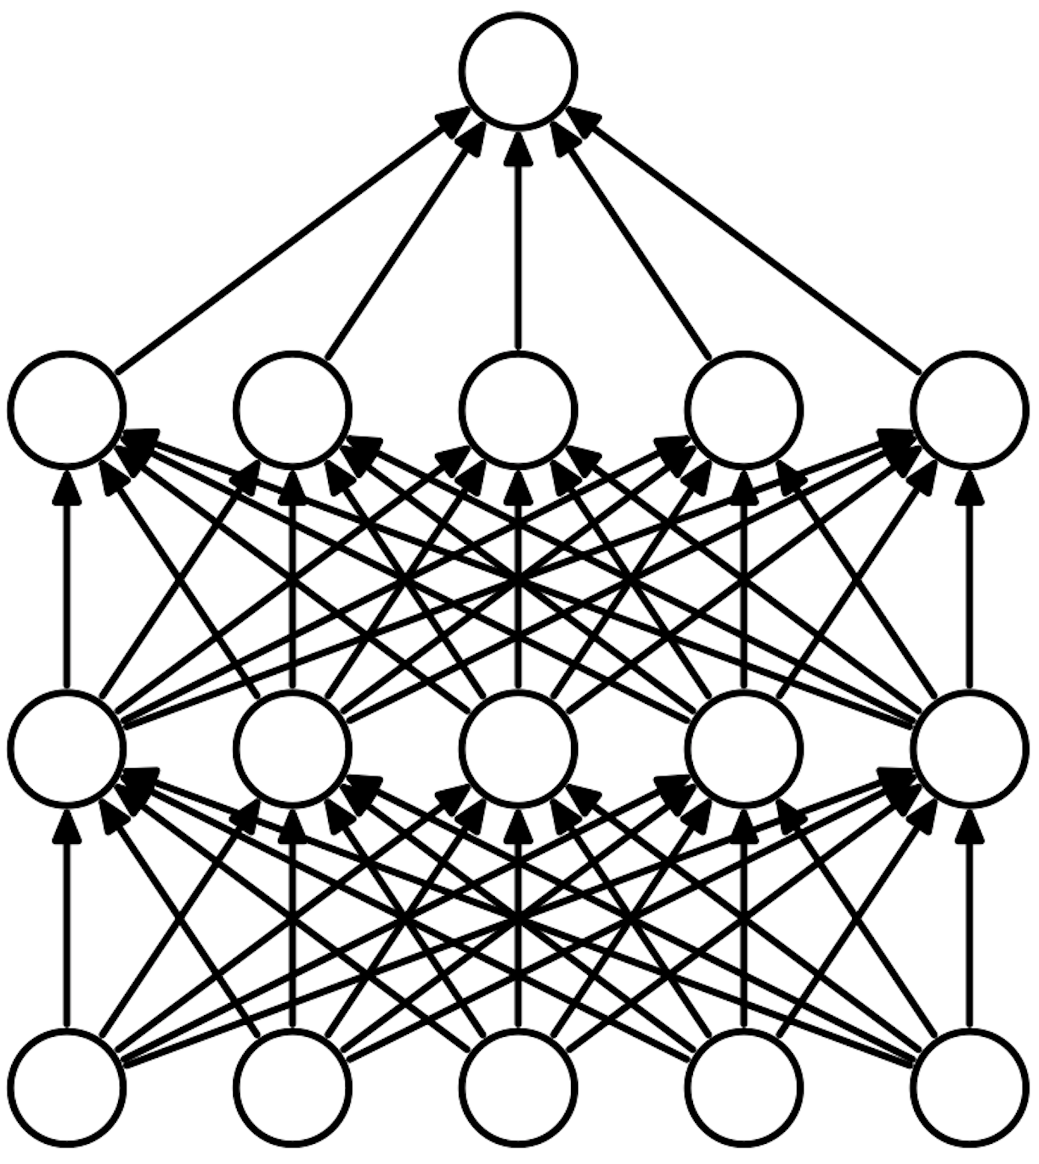
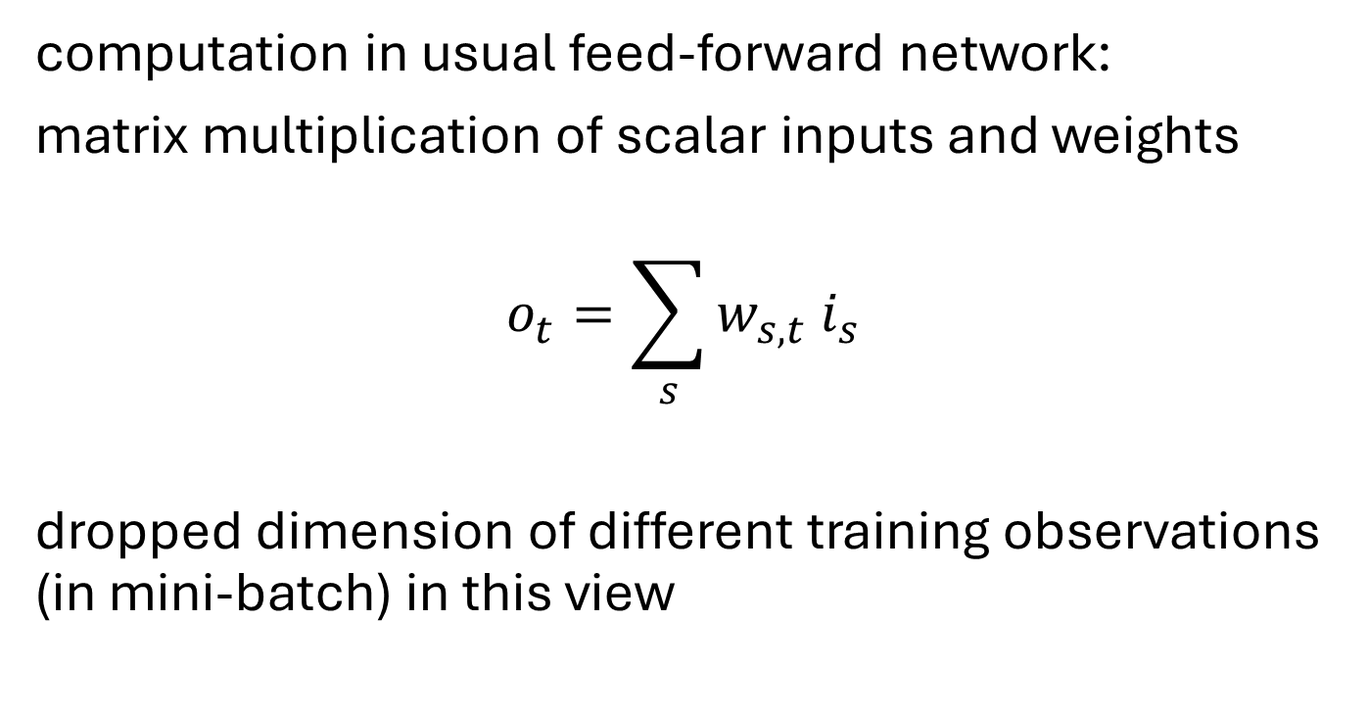
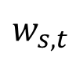
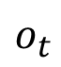
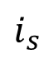
Recap: Feed-Forward Neural Networks
computation in usual feed-forward network:
matrix multiplication of scalar inputs and weights
$$o_{t}=\sum_{s}{w_{s,t} i_{s}}$$
dropped dimension of different training observations (in mini-batch) in this view
$$o_{t}$$
$$w_{s,t}$$
$$i_{s}$$

Slide 27
Inductive Bias
plain feed-forward networks very inefficient for image classification:
make no use of spatial structure (locality of objects)
→ need to learn it from scratch
better way: introduce it right in the architecture of the ML method (called inductive bias)
→ convolution with spatial filters (learned rather than handcrafted)

Slide 28
Convolutional Neural Networks (CNN or ConvNet)

Slide 29
Grid-Like Data
scalar values (like in usual feed-forward network)
image data: 2-D grid of pixels (spatial structure)
convolutional networks:
neural networks using learned convolution kernels as weights (in place of general matrix multiplications)
→ highly regularized feed-forward networks
source

Slide 30


Convolution Operation
2D convolution
actually, correlation (convolution would have $−$ here):
$$o_{x,y}=\sum_{s,t}{{w_{s,t} i}_{x+s,y+t} }$$
(again, dropping dimension of different training observations)
feature map
(transformed image)
kernel
(learned)
image
(input or feature map)
source

Slide 31


Regularization Effects
convolutional layer:
sparse interactions: much less weights
parameter sharing: use same weights for different connections
effect of receptive field over several layers:
consider only locally restricted number of input values from previous layer
grows for earlier layers (indirect interactions)
→ hierarchical patterns from simple building blocks (many aspects of nature hierarchical)
fully-connected layer:
source

Slide 32


Channel Mixing
several input channels $c$ (RGB) and several output channels $f$ (different feature maps):
$$o_{f,x,y}=\sum_{c,s,t}{w_{f,c,s,t}{ i}_{c,x+s,y+t}}$$
one feature map
source

Slide 33


Striding and Padding
need to define how to stride over image
stride $>1$ corresponds to down-sampling
→ fewer nodes after convolutional layer
zero-padding of input to make it wider:
otherwise shrinking of represenation with each layer (depending on kernel size)
→ needed for large kernels and several layers
stride 1
kernel
0
input
stride 2
source

Slide 34


Another Ingredient: Pooling
max pooling:
replacing outputs of neighboring nodes with summary statistic (e.g., maximum or average value of nodes)
→ non-linear downsampling (regularization)
pooling is translation invariant: no interest in exact position of, e.g., maximum value
pooling over features learned by separate kernels (cross-channel pooling) can also learn other transformation invariances, like rotation or scale
(convolutions can detect same translated motif across entire image, but not rotated or scaled versions of it)
from wikipedia
source

Slide 35

Putting It All Together
convolutional neural networks in short:
local connections, shared weights, pooling, many layers
many images (training examples), potentially with several channels
several kernels producing several feature maps
downsampling
flatten dimensions for final classification
source

Slide 36

Hierarchical Learning
shown here: top 9 activations of some random feature maps on test images, together with corresponding image patches
(projected down to pixel space using deconvolutional network)
some insights:
strong groupings in feature maps, with exaggeration of discriminative image parts
more global activations at higher layers
greater invariance at higher layers
source

Slide 37

t-SNE Visualization
approach:
for every image, embed high-dimensional vector of last hidden layer’s activations (right before final fully-connected classification layer) into two-dimensional vector (while preserving distances)
→ semantic similarities
source

Slide 38

Data Augmentation
adding different variations of input data to training
idea: supporting the model in maintaining desired invariances

Slide 39

AlexNet finally started the deep learning hype.
(winning the ImageNet challenge in 2012)
from wikipedia

Slide 40


Rise of Deep Learning
a little bit oversimplified:
deep learning = lots of training data + parallel computation + smart algorithms
AlexNet: ImageNet (with data augmentation) + GPUs + ReLU, dropout, SGD
source

Slide 41


Slide 42


VGG
ResNet

Slide 43


Skip Connections
residual mapping (special kind of skip/shortcut connections):
ResNet
issue: degradation of training and test errors when adding more and more layers → not due to overfitting (but reason controversial)
solution: learning of residuals by means of skip connections (resulting in combination of different paths through computational graph)
→ produces loss functions that train easier
together with batch normalization (avoiding exploding gradients), skip connections enable extremely deep networks (>1000 layers) without degradation
(preserving the gradient)
loss surface:
source

Slide 44
Foundation Models
problem with ConvNets trained from scratch (in fact, with all ML methods): only suited for domain of training data
idea of transfer learning:
pretrain a big model (called foundation model) on a broad data set, and then use these learnings for subsequent trainings on specific (typically, narrow) data
two forms of transfer learning: feature extraction and finetuning

Slide 45
Feature Extraction
approach:
get a pretrained ConvNet as foundation model
remove final fully-connected layer (its outputs are the class scores from the pretraining task)
pass training data (for the task at hand) through the network
for each image, extract vector of last hidden layer‘s activations (e.g., 4096-dimensional for AlexNet)
use the extracted values as features to train another model (to be adjusted to the task at hand)
(same idea as used before for SIFT features)

Slide 46

Finetuning
options: finetune all weights or just some
approach:
get pretrained ConvNet as foundation model
continue (starting with weights after pretraining) training with data for task at hand
typically, need to change architecture of final layer: different number of classes
source

Slide 47
Finetuning Scenarios
finetuning gives better adjustment to new task than feature extraction (important if new task differs a lot from pretraining task)
→ coming along with danger of overfitting
ConvNet features more generic in early layers (e.g., edges) and more specific to the data set of pretraining in later layers
→ for small finetuning data sets, typically keep weights of early layers fixed to avoid overfitting
for large finetuning data sets (less danger of overfitting), finetuning all layers can be beneficial

Slide 48
Different Image Classification Techniques
Hough transform: looking for predefined shapes such as lines or circles (feature-based recognition)
feature description & matching: identify specific object instances (typically used for instance rather than class recognition)
image features as input to classic ML method: generalization from data
plain feed-forward network on raw image data: even more generalization without handcrafted components
convolutional neural networks: use of spatial structure (inductive bias)
pretraining & finetuning (or feature extraction): transfer learning

Slide 49
Semantic Segmentation

Slide 50


PASCAL VOC Data Set
PASCAL Visual Object Class challenge
widely used as benchmark for object detection and semantic segmentation
20 object categories such as person, sofa, sheep, car, …
11530 annotated images
available annotations: pixel-level segmentation, bounding boxes, object classes

Slide 51

MS COCO Data Set
Microsoft Common Objects in Context
images of complex everyday scenes containing common objects in their natural context
91 objects types
2.5 million annotated instances in 328k images → instance segmentation

Slide 52

Object Segmentation from DINO
thresholding self-attention map of last layer:
not a full segmentation mask though …
source

Slide 53


Classification of Each Pixel
segmentation: no objects, just pixels
minimize sum over classification losses (cross-entropy loss at every output pixel)

Slide 54


Idea: Fully Convolutional, No Downsampling
stride 1,
padding
→ small kernels
feature maps
categories
replace flattened, fully-connected classification layers with $1×1$ convolutions
→ maintain spatial relationships and enable pixel-wise classification: conversion of feature maps into classification heat maps (one for each class)
but no downsampling means small receptive field and no hierarchical learning

Slide 55



Upsampling to the Rescue
Fully Convolutional Networks
typical spatial feature extraction: convolution and pooling layers → downsampling
upsampling layers to restore original image size
pixel-wise classification
different options for down- (pooling, strided convolution) and upsampling ...

Slide 56



Reverse Pooling
unpooling (recording max positions from pooling)
resampling (no learned parameters)
source
filled with learned parameters in subsequent convolution

Slide 57



Reverse Convolution
transposed convolution
convolution
combine and sum overlaps:
not inverse convolution
→ additional learned parameters
source

Slide 58

U-Net
number of channels / feature maps
just two classes
skip connections
also used for learning of depth maps, image synthesis (diffusion), ...

Slide 59
Aside: Autoencoders

Slide 60

Autoencoder
for images:
convolutions
transposed convolutions
(deep) encoder network
(deep) decoder network
learned together by minimizing differences between original input and reconstructed input (expressed as losses)
compressed intermediate representation: dimensionality reduction
(alternative to PCA)
unsupervised learning
source

Slide 61

Denoising Autoencoder
goal: avoid overfitting and improve robustness of plain autoencoder
learn to remove noise of distorted input $\tilde{x}$ → restore original input $x$
similar to dropout
source
alternative to deconvolution (image restoration)

Slide 62
Object Detection

Slide 63

output: bounding boxes with category label and confidence

Slide 64

Performance Evaluation of Localization
Intersection-over-Union
images with multiple objects: number of detections dependent on used confidence threshold

Slide 65

too complicated for multiple objects

Slide 66





Localization for Multiple-Object Images
idea: classify many different crops of the image as object or background
(crops: sliding window over image, iterated at multiple window sizes)
Dog? No
Cat? No
Background? Yes
Dog? Yes
Cat? No
Background? No
Dog? Yes
Cat? No
Background? No
Dog? No
Cat? Yes
Background? No
issue: too many possible crops
→ need for region proposals

Slide 67


Region-Based Convolutional Neural Network (R-CNN)
task-specific heads:
two stages
object classification
feature representation
(forward-pass through pretrained CNN)
bounding-box refinement
region proposals by “classic” method (~2k)

Slide 68



Fast R-CNN: Crop ConvNet Features
Fully Convolutional Network
(pretrained, e.g., VGG-16)
feature sharing
end-to-end trainable
fixed-dimensional representation for each proposed region
or CNN
more lightweight
Region of Interest pooling:
map proposed RoI coordinates to feature map
divide RoI on feature map into fixed bins (e.g., $7x7$ grid)
max pooling in each bin

Slide 69


Faster R-CNN: Use Region Proposal Network
two RPN losses combined with two detection head losses during end-to-end training
binary classification (object or not) with sliding window (e.g., $3x3$) over feature map, refining predefined anchor boxes

Slide 70


Feature Pyramid Network (FPN)
different intermediate layers of same backbone CNN
high-resolution features improve detection of small objects
using different anchor sizes for different pyramid levels

Slide 71

Single-Stage Detectors: Drop Per-Region Computation
or more
faster, but usually worse performance

Slide 72


YOLO: Real-Time Object Detection
anchor-free approach in newer YOLO versions
You Only Look Once:
prediction of bounding boxes and class probabilities in one go

Slide 73
Instance Segmentation

Slide 74



Add Additional Network Heads to R-CNN
instance segmentation (Mask R-CNN):
pose estimation (DensePose):
3D model’s surface to 2D

Slide 75

→ total loss is sum of RPN, detection-head, and mask-head losses
Faster R-CNN
detection head:
using bilinear interpolation to avoid quantization errors
object detection (boundary boxes)
prediction of separate binary masks for each detected object (specific instances)

Slide 76


image with training proposal
$28×28$ mask target
image with training proposal
$28×28$ mask target

Slide 77

results on MS COCO data set

Slide 78

Panoptic Segmentation
unification of semantic sementation (labeling all pixels) and instance segmentation (identifying individual objects)
each pixel is assigned
a class label (e.g., road, car)
an instance ID, if it belongs to a “thing” class (e.g., car #1, car #2)
covering both “thing” classes (countable objects) and “stuff” classes (uncountable regions like sky, grass, road)
e.g., with combination of Mask R-CNN and fully-convolutional head (or DETR variants such as Mask2Former)
source

Slide 79


Promptable Segmentation with Transformers
Segment Anything Model (SAM)
SAM2 includes also video segmentation
transformer decoder
ViT
CLIP

Slide 80
Image Synthesis

Slide 81

example: DALL-E 2
idea: generate new images as variations of training data (same distribution)
usually conditioned on text (prompt)
compared to text generation, additional mechanism needed (e.g., diffusion) due to more complex image structures

Slide 82


plenty of products: DALL-E, Stable Diffusion, ImageGen, Midjourney, ...
Stable Diffusion:
inpainting example (GLIDE ):
A scenic view of mountains at sunset, digital art
prompt
source

Slide 83

Generative vs Predictive/Discriminative Models
discriminative model
generative model
discriminative models:
predict conditional probability $P\left(Y|X\right)$
generative models:
predict joint probability $P\left(Y,X\right)$
(or just $P\left(X\right)$ → unsupervised learning)
→ allow to generate new data samples
source
task of generative models more difficult: need to model full data distribution rather than merely find patterns in inputs to distinguish outputs
Generative models can be used for predictive tasks (Bayes theorem).
But predictive models are usually better at it.

Slide 84






Classic ML vs Deep Learning
Generative vs Predictive Models
text generation
image synthesis
text-to-video
ChatGPT
Stable Diffusion 3 — Stability AI
Sora | OpenAI
BERT family
tabular data
computer vision
YOLO

Slide 85
Deep Learning for Generative AI
Depending on the application, there are currently two dominant approaches for generative AI:
text generation: LLMs
image synthesis: diffusion models
note the difference between image synthesis and multimodal understanding in LLMs (images as additional input sequences to transformer, tokenized by splitting into patches)

Slide 86

Different Model Types for Image Synthesis
two neural networks playing a zero-sum game
learn variational distribution (not just replicating inputs)
more complex distributions by applying change-of-variable technique (need for specialized architecture)
chain of denoising autoencoders
→ generalization: flow matching
source

Slide 87


Generative Modeling

